Slide 1
Programming with Parallel Migratable Objects
Sanjay Kalé and PPL
Parallel Programming Laboratory
University of Illinois at Urbana-Champaign

Slide 2
Manual: http://charm.cs.illinois.edu/manuals/html/charm++/manual.html
Installation: http://charm.cs.illinois.edu/manuals/html/charm++/A.html

Slide 3
Outline
Introduction
Object Design
Execution Model
Hello World
Benefits of Charm++
Charm++ Basics
Object Collections
Overdecomposition
Migratability
Checkpointing and Resilience
Structured Dagger
Application Design
Performance Tuning
Using Dynamic Load Balancing
Interoperability
Debugging
Further Optimization

Slide 4
Harnessing Parallelism: Challenges Trends in System Architecture
Frequencies have stopped increasing
Memory costs are high
Relatively low per core memory
Increasing heterogeneity
Accelerators, SMT
Energy, power, and thermal considerations
Frequent component failures

Slide 5
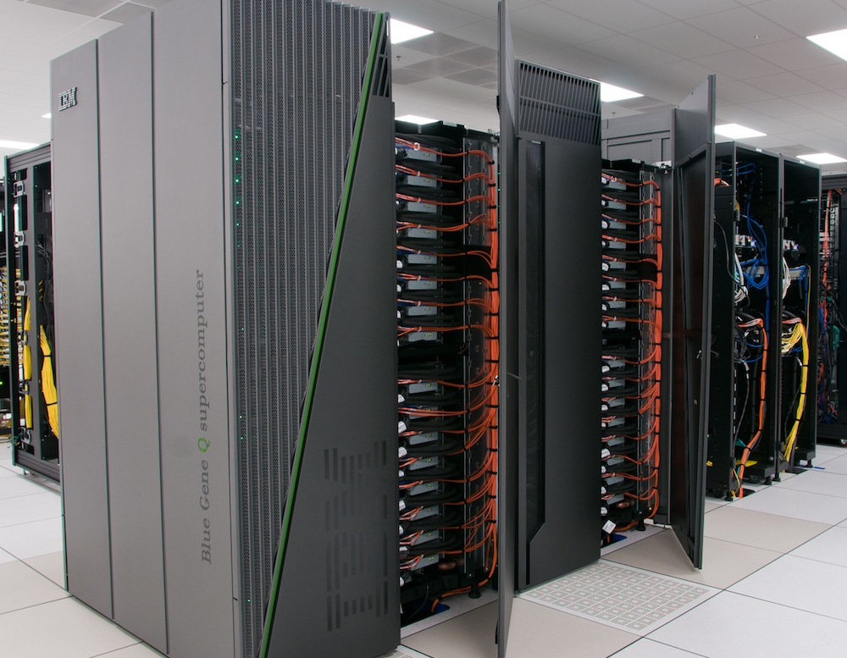
Harnessing Parallelism: Challenges Trends in System Architecture
However, compute resources are not faster cores, but more cores
Unprecedented levels of available concurrency
IBM BG/Q
‘Sequoia’: 1,572,864 cores
‘Mira’: 786,432 cores
Cray
XE6+XK6 ‘Bluewaters‘: 386,816 cores
XK6 ‘Titan’: 299,008 cores
K Supercomputer: 705,024 cores
Mid-size clusters will be ubiquitous
Implications
Each thread of execution has to:
Operate on lesser data
Wait relatively longer for remote data
Have to operate in strong scaling regime

Slide 6
Harnessing Parallelism: Challenges Next-generation Applications
Need for strong scaling
Faster solutions (not just larger problems)
Application Characteristics
Multi-resolution
Adaptive, spatial and temporal resolutions
Dynamic/adaptive refinements: to handle application variation
Multi-module (multi-physics)
Complex physics in multiple, interacting modules
Adapt to a volatile computational environment
Exploit heterogeneous architecture
Deal with thermal and energy considerations
So? Consequences:
Must support automated resource management
Must support interoperability and parallel composition

Slide 7
Harnessing Parallelism: Challenges Programming Models: MPI
Highly successful
Universally used
Has supported application evolution from gigascale to petascale
Library
Communication primitives
MPI does not directly support automated resource management (e.g. load balancing, fault tolerance, etc.)

Slide 8
Charm++ builds upon a proven approach: objects

Slide 9
Stuff you already know Benefits of Object-based code
Objects encapsulate data
Methods represent functionality relevant to that data
Method invocations can modify / update state of the object / data
Computation can be expressed in terms of objects interacting via method invocations
Methods are natural units of sequential computation on object data
Thoughtful design yields focused methods with single purpose
Naturally expresses an object’s response to inputs (signals / data)
Nothing new
Still quite uncommon in HPC code
Its not about language syntax. Its about program structure

Slide 10
Globally-Visible Objects: Chares and Proxies
2
8
4
Parallel Address Space
6
F
C
E
G
B
D
H
A
0
3
7
5
9
1
Certain “special” object instances are:
first-class citizens in the parallel address space,
with unique location-independent names
Under the hood, the runtime handles locality and provides the mechanisms to promote objects to the parallel space

Slide 11
Globally-Visible Methods: Entry Methods
Parallel Address Space
F.m4()
E.m1()
G
F
C
E.m3()
E
G.m2()
B.m2()
B
D
H.m2()
A
H
How can objects communicate across address spaces?
Just like a sequential object-oriented language, an object’s reference is used to invoke a method
In the parallel space, this is a handle that is location transparent
A method invocation becomes an act of communication

Slide 12
Method-Driven Asynchronous Communication
What happens if an object waits for a return value from a method invocation?
Performance
Latency
Reasoning about correctness

Slide 13
Design Principle: Do not wait for remote completion
Hence, method invocations should be asynchronous
No return values
Computations are driven by the incoming data
Initiated by the sender or method caller

Slide 14
For example, a Jacobi reduction

Slide 15
Methods: Natural Units of Sequential Computation
Methods still have the same sequential semantics
Atomicity: methods do not execute in parallel
Methods cannot be interrupted or preempted
Methods interact and update state of an object in the same way
Method sequencing is what changes from sequential computation

Slide 17
The Execution Model
Several objects live on a single PE
For now, think of it as a core (or just “processor”)
As a result,
Method invocations directed at objects on that processor will have to be stored in a pool,
And a user-level scheduler will select one invocation from the queue and runs it to completion
A PE is the entity that has one scheduler instance associated with it
Notes:
Made image from slides from presentation I made with these objects: loadBalancingBasics_SMD.pptx

Slide 18
The Execution Model
Execution is triggered by availability of a “message” (a method invocation)
When an entry method executes,
it may generate messages for other objects
the RTS deposits them in the message Q on the target processor
Notes:
Made image from slides from presentation I made with these objects: loadBalancingBasics_SMD.pptx

Slide 19
Outline
Introduction
Object Design
Execution Model
Hello World
Benefits of Charm++
Charm++ Basics
Object Collections
Overdecomposition
Migratability
Checkpointing and Resilience
Structured Dagger
Application Design
Performance Tuning
Using Dynamic Load Balancing
Interoperability
Debugging
Further Optimization

Slide 20
Hello World Example
hello.ci file
mainmodule hello {
mainchare Main {
entry Main(CkArgMsg ∗m);
};
};
hello.cpp file
#include <stdio.h>
#include ”hello.decl.h”
class Main : public CBase Main {
public: Main(CkArgMsg∗ m) {
ckout << ”Hello World!” << endl;
CkExit();
};
};
#include ”hello.def.h”

Slide 21
Hello World with Chares
hello.cpp file
#include <stdio.h>
#include ”hello.decl.h”
class Main : public CBase Main {
public: Main(CkArgMsg∗ m) {
CProxy Singleton::ckNew();
};
};
class Singleton : public
CBase Singleton {
public: Singleton() {
ckout << ”Hello World!” << endl;
CkExit();
};
};
#include ”hello.def.h”
hello.ci file
mainmodule hello {
mainchare Main {
entry Main(CkArgMsg ∗m);
};
chare Singleton {
entry Singleton();
};
};

Slide 22
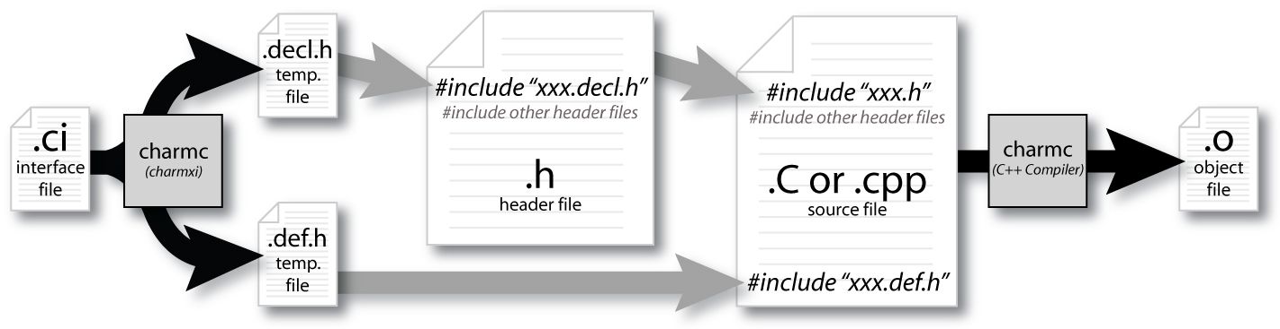
Compiling a Charm++ Program

Slide 23
Building Charm++
git clone http://charm.cs.uiuc.edu/gerrit/charm
./build <TARGET> <ARCH> <OPTS>
TARGET = Charm++, AMPI, bgampi, LIBS etc.
ARCH = net-linux-x86 64, multicore-darwin-x86 64, pamilrts-bluegeneq etc.
OPTS = –with-production, –enable-tracing, xlc, smp, -j8 etc.
http://charm.cs.illinois.edu/manuals/html/charm++/A.html

Slide 24
Hello World Example
Compiling
charmc hello.ci
charmc -c hello.C
charmc -o hello hello.o
Running
./charmrun +p7 ./hello
The +p7 tells the system to use seven cores

Slide 25
Outline
Introduction
Object Design
Execution Model
Hello World
Benefits of Charm++
Charm++ Basics
Object Collections
Overdecomposition
Migratability
Checkpointing and Resilience
Structured Dagger
Application Design
Performance Tuning
Using Dynamic Load Balancing
Interoperability
Debugging
Further Optimization

Slide 26
Impact on communication
Current use of communication network
Compute-communicate cycles in typical MPI apps
Network is used for a fraction of time
And is on the critical path
Hence, current communication networks are over-engineered by necessity
With overdecomposition
Communication is spread over an iteration
Adaptive overlap of communication and computation

Slide 27
Example Computation
Consider a simple stencil computation
With traditional design based on traditional methods (e.g. MPI-based)
Each processor has a chunk, which alternates between computing and communicating
With Charm++
Multiple chunks on each processor
Wait time for each chunk overlapped with useful computation for others
Communication spread over time

Slide 28
Example: Stencil Computation
Stencil in MPI: No overlap among computation and communication
Stencil in Charm: Communication of a chare overlaps with computation of others

Slide 29
Modularity and Compositionality
Without message-driven execution (and virtualization), you get either: Space-division

Slide 30
Modularity and Compositionality
Sequentialization

Slide 31
Modularity and Compositionality
Parallel Composition: A1; (B —— C ); A2
Recall: Different modules, written in different languages/paradigms, can overlap in time and on processors, without programmer having to worry about this explicitly

Slide 32
Migratability
Once the programmer has written the code without reference to processors, all of the communication is expressed among objects
The system is free to migrate the objects across processors as and when it pleases
It must ensure it can deliver method invocations to the objects, whereever they go
This migratability turns out to be a key attribute for empowering an adaptive runtime system

Slide 33
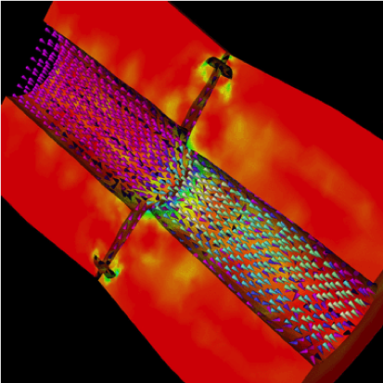
Decomposition Independent of numCores
Rocket simulation under traditional MPI
Rocket simulation with migratable objects
Benefits: load balance, communication optimizations, modularity

Slide 34
Utility for Multi-cores, Many-cores, Accelerators
Objects connote and promote locality Message-driven execution is
A strong principle of prediction for data and code use
Much stronger than principle of locality
Can be used to scale memory wall
Prefetching of needed data, e.g, into scratch pad memories
Notes:
Made image from slides from presentation I made with these objects: loadBalancingBasics_SMD.pptx

Slide 35
Load Balancing
Static
Irregular applications
Programmer shouldn’t have to figure out ideal mapping
Dynamic
Applications are increasingly using adaptive strategies
Abrupt refinements
Continuous migration of work: e.g. particles in MD
Challenges
Performance limited by most overloaded processor
The chance that one processor is severely overloaded gets higher as #processors increases
Migratable Objects Empower Automated Load Balancing!

Slide 36
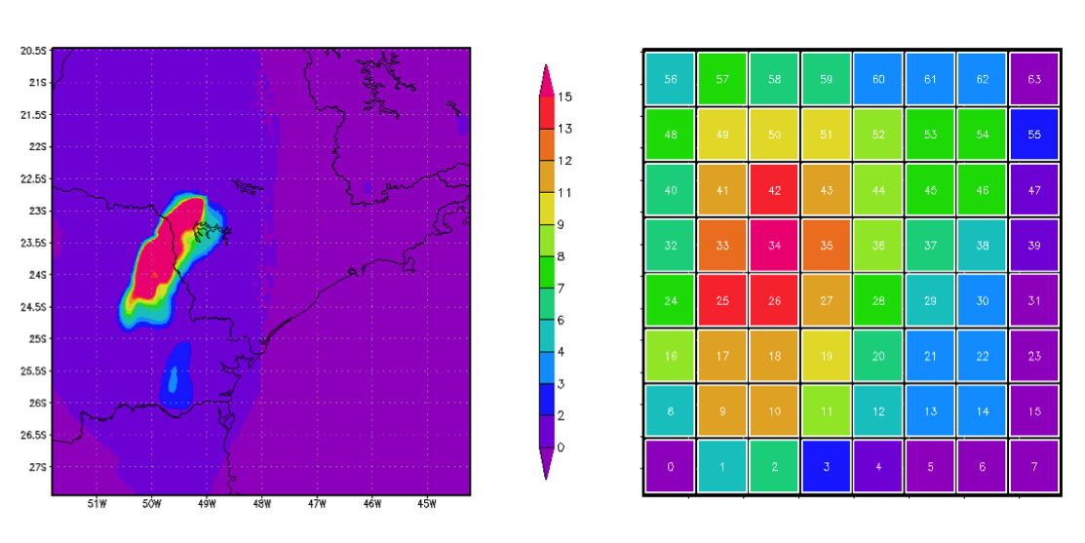
A quick Example Weather Forecasting in BRAMS
Brams: Brazillian weather code (based on RAMS)
AMPI version (Eduardo Rodrigues, with Mendes and J. Panetta)

Slide 37
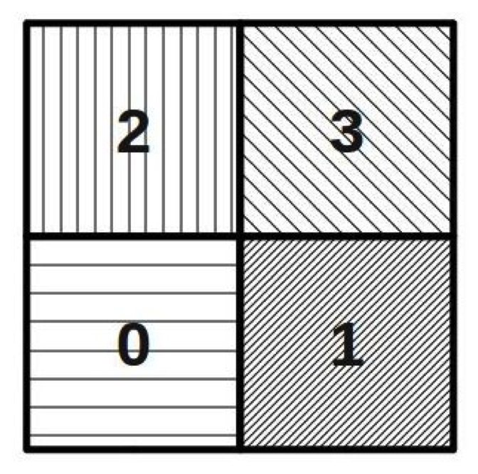
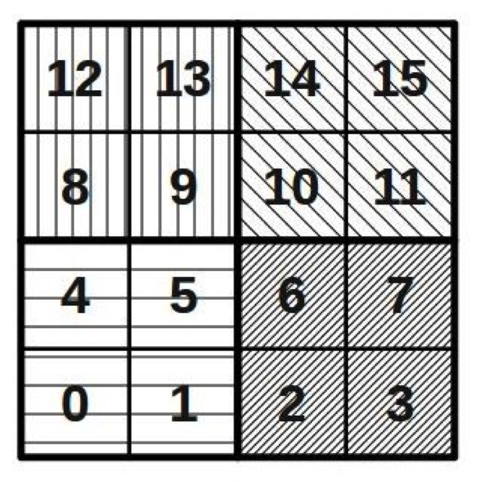
Basic Virtualization of BRAMS

Slide 38
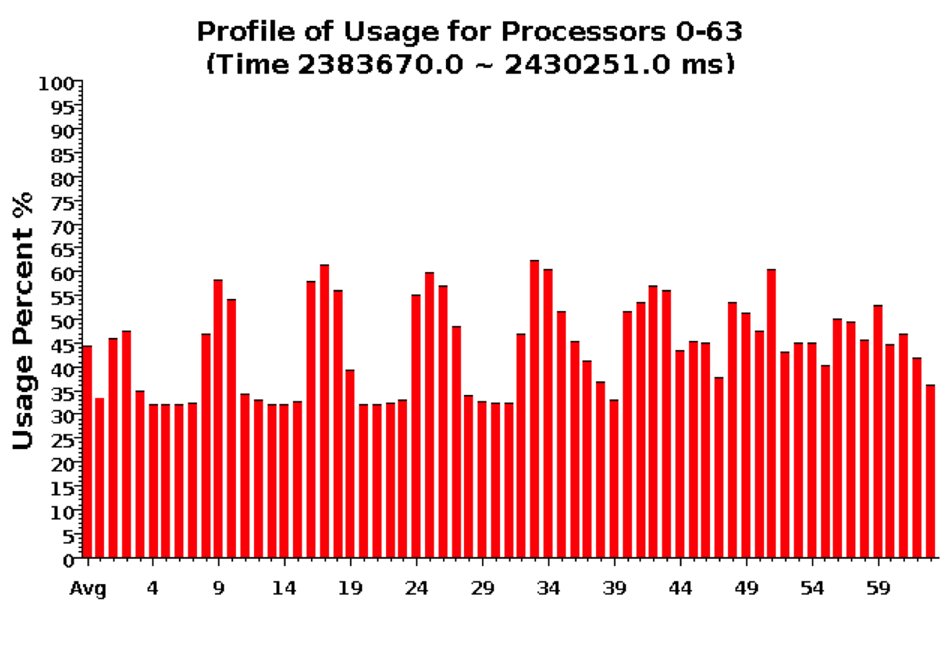
Baseline: 64 objects on 64 processors

Slide 39
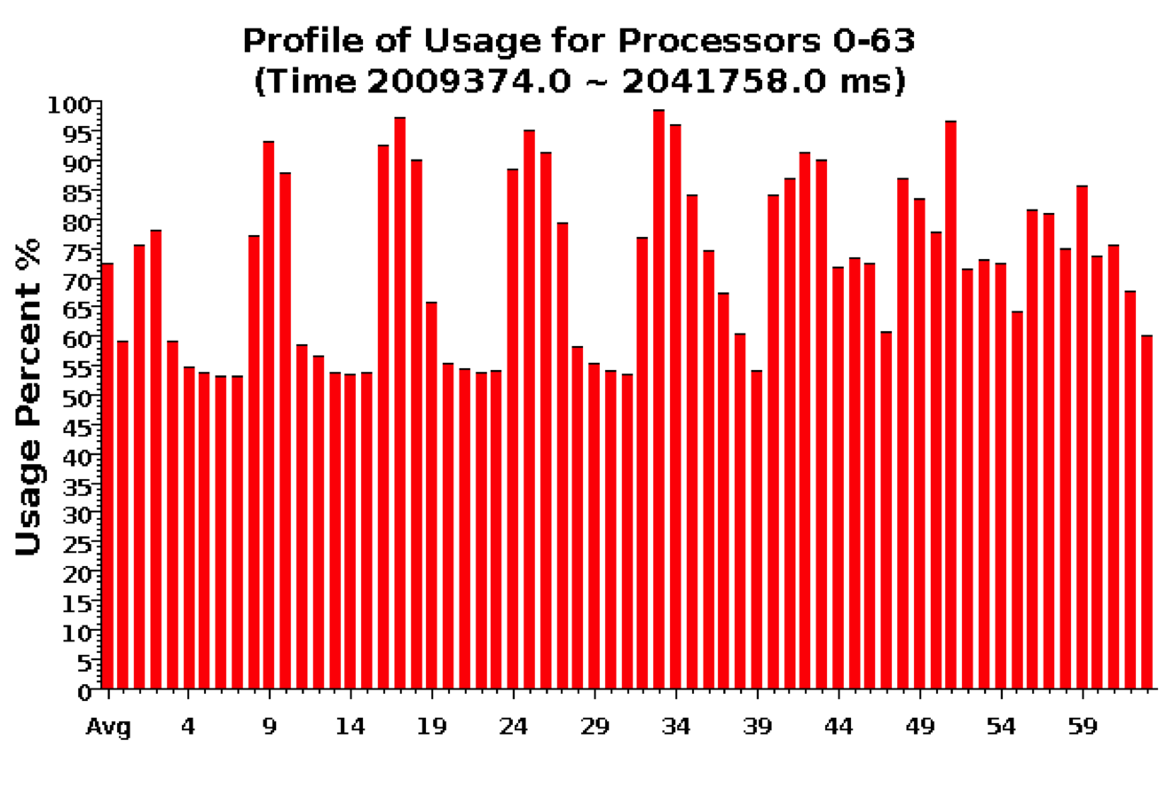
Over-decomposition: 1024 objects on 64 processors Benefits from communication/computation overlap

Slide 40
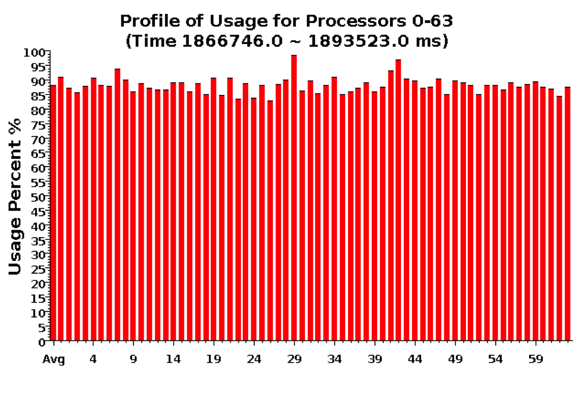
With Load Balancing: 1024 objects on 64 processors
No overdecomp (64 threads): 4988 sec
Overdecomp into 1024 threads: 3713 sec
Load balancing (1024 threads): 3367 sec

Slide 41
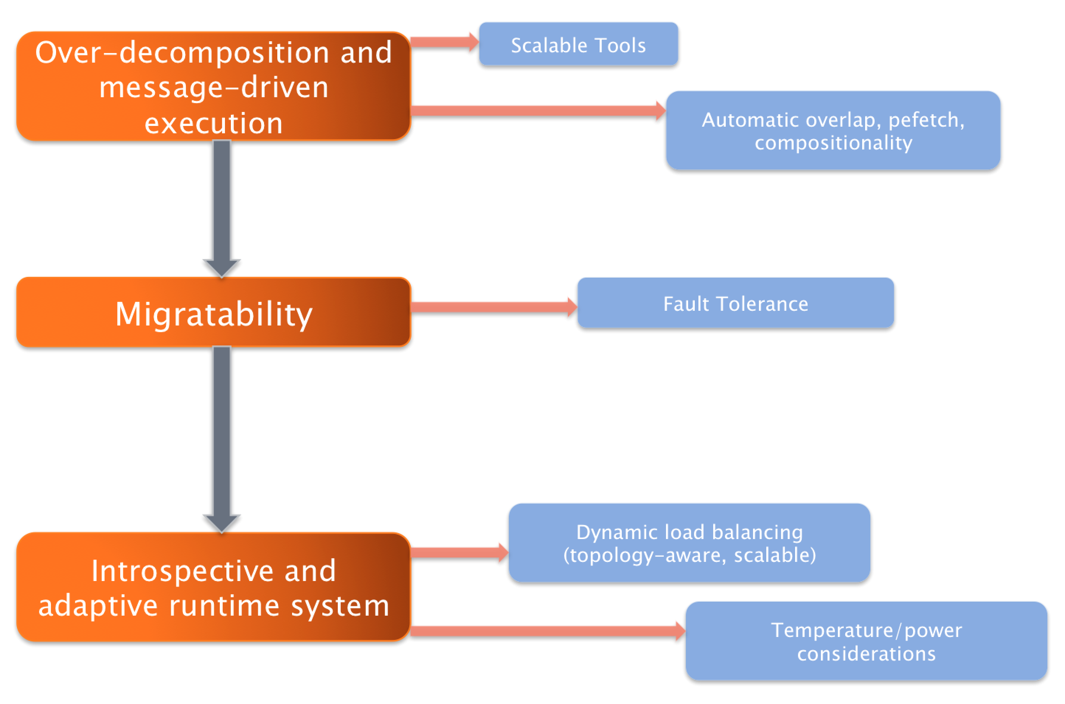

Slide 42
Outline
Introduction
Object Design
Execution Model
Hello World
Benefits of Charm++
Charm++ Basics
Object Collections
Overdecomposition
Migratability
Checkpointing and Resilience
Structured Dagger
Application Design
Performance Tuning
Using Dynamic Load Balancing
Interoperability
Debugging
Further Optimization

Slide 43
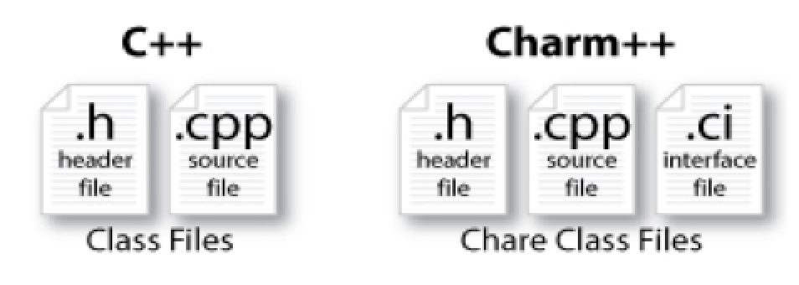
Charm++ File structure
C++ objects (including Charm++ objects)
Defined in regular .h and .C files
Chare objects, entry methods (asynchronous methods)
Defined in .ci file
Implemented in the .C file

Slide 44
Charm Interface: Modules
Charm++ programs are organized as a collection of modules
Each module has one or more chares
The module that contains the mainchare, is declared as the mainmodule
Each module, when compiled, generates two files:
MyModule.decl.h and MyModule.def.h
.ci file
[main]module MyModule {
//... chare definitions ...
};

Slide 45
Charm Interface: Chares
Chares are parallel objects that are managed by the RTS
Each chare has a set entry methods, which are asynchronous methods that may be invoked remotely
The following code, when compiled, generates a C++ class CBase_MyChare that encapsulates the RTS object
This generated class is extended and implemented in the .C file
.ci file
[main]chare MyChare {
//... entry method definitions ...
};
.C file
class MyChare : public CBase MyChare {
//... entry method implementations ...
};

Slide 46
Charm Interface: Entry Methods
Entry methods are C++ methods that can be remotely and asynchronously invoked by another chare
.ci file
entry MyChare(); /∗ constructor entry method ∗/
entry void foo();
entry void bar(int param);
.C file
MyChare::MyChare() { /∗... constructor code ...∗/ }
MyChare::foo() { /∗... code to execute ...∗/ }
MyChare::bar(int param) { /∗... code to execute ...∗/ }

Slide 47
Charm Interface: mainchare
Execution begins with the mainchare’s constructor
The mainchare’s constructor takes a pointer to system-defined class CkArgMsg
CkArgMsg contains argv and argc
The mainchare will typically creates some additional chares

Slide 48
Creating a Chare
A chare declared as chare MyChare {...}; can be instantiated by the following call:
CProxy MyChare::ckNew(... constructor arguments ...);
To communicate with this class in the future, a proxy to it must be retained
CProxy MyChare proxy =
CProxy MyChare::ckNew(... constructor arguments ...);

Slide 49
Chare Proxies
A chare’s own proxy can be obtained through a special variable thisProxy
Chare proxies can also be passed so chares can learn about others
In this snippet, MyChare learns about a chare instance main , and then invokes a method on it:
.ci file
entry void foobar2(CProxy Main main);
.C file
MyChare::foobar2(CProxy Main main) {
main.foo();
}

Slide 50
Charm Termination
There is a special system call CkExit() that terminates the parallel execution on all processors (but it is called on one processor) and performs the requisite cleanup
The traditional exit() is insufficient because it only terminates one process, not the entire parallel job (and will cause a hang)
CkExit() should be called when you can safely terminate the application (you may want to synchronize before calling this)

Slide 51
Chare Creation Example: .ci file
mainmodule MyModule {
mainchare Main {
entry Main(CkArgMsg ∗m);
};
chare Simple {
entry Simple(int x, double y);
};
};

Slide 52
Chare Creation Example: .C file
#include <stdio.h>
#include ”MyModule.decl.h”
class Main : public CBase Main {
public: Main(CkArgMsg∗ m) {
ckout << ”Hello World!” << endl;
if (m->argc > 1) ckout << “ Hello” << m->argv[1] << “!!!” << endl;
double pi = 3.1415;
CProxy_Simple::ckNew(12, pi);
};
};
class Simple : public CBase_Simple {
public: Simple(int x, double y) {
ckout << “ Hello from a simple chare running on ” << CkMyPe() << endl;
ckout << “ Area of a circle of radius” << x << “ is ” << y*x*x << endl;
CkExit();
};
};
#include “MyModule.def.h”

Slide 53
Asynchronous Methods
Entry methods are invoked by performing a C++ method call on a chare’s proxy
CProxy MyChare proxy =
CProxy MyChare::ckNew(... constructor arguments ...);
proxy.foo();
proxy.bar(5);
The foo and bar methods will then be executed with the arguments, wherever the created chare, MyChare, happens to live
The policy is one-at-a-time scheduling (that is, one entry method on one chare executes on a processor at a time)

Slide 54
Asynchronous Methods
Method invocation is not ordered (between chares, entry methods on one chare, etc.)!
For example, if a chare executes this code:
CProxy MyChare proxy = CProxy MyChare::ckNew(); proxy.foo();
proxy.bar(5);
These prints may occur in any order
MyChare::foo() {
ckout << ”foo executes” << endl;
}
MyChare::bar(int param) {
ckout << ”bar executes with ” << param << endl;
}

Slide 55
Asynchronous Methods
For example, if a chare invokes the same entry method twice:
proxy.bar(7);
proxy.bar(5);
These may be delivered in any order
MyChare::bar(int param) {
ckout << ”bar executes with ” << param << endl;
}
Output
OR
bar executes with 5
bar executes with 7
bar executes with 7
bar executes with 5

Slide 56
Asynchronous Example: .ci file
mainmodule MyModule {
mainchare Main {
entry Main(CkArgMsg ∗m);
};
chare Simple {
entry Simple(double y);
entry void findArea(int radius, bool done);
};
};

Slide 57
Asynchronous Example: .C file
Does this program execute correctly?
struct Main : public CBase_ Main {
Main(CkArgMsg∗ m) {
double pi = 3.1415;
CProxy Simple sim = CProxy Simple::ckNew(pi);
for (int i = 1; i< 10; i++) sim.findArea(i, false);
sim.findArea(10, true);
};
};
struct Simple : public CBase Simple {
float y;
Simple(double pi) {
y = pi;
ckout << ”Hello from a simple chare running on ” << CkMyPe() << endl;
}
void findArea(int r, bool done) {
ckout << ”Area of a circle of radius” << r << ” is ” << y∗r∗r << endl;
if (done) CkExit();
}

Slide 58
Data types and entry methods
You can pass basic C++ types to entry methods (int, char, bool, etc.)
C++ STL data structures can be passed by including pup_stl.h Arrays of basic data types can also be passed like this:
.ci file:
entry void foobar(int length, int data[length]);
.C file
MyChare::foobar(int length, int∗ data) {
// ... foobar code ...
}

Slide 59
Collections of Objects: Concepts
Objects can be grouped into indexed collections
Basic examples
Matrix block
Chunk of unstructured mesh
Portion of distributed data structure
Volume of simulation space
Advanced Examples
Abstract portions of computation
Interactions among basic objects or underlying entities

Slide 60
Collections of Objects
Structured: 1D, 2D, . . . , 6D
Unstructured: Anything hashable
Dense
Sparse
Static - all created at once
Dynamic - elements come and go

Slide 61
Chare Array: Hello Example
mainmodule arr {
mainchare Main {
entry Main(CkArgMsg∗);
}
array [1D] hello {
entry hello(int);
entry void printHello();
}
}

Slide 62
Chare Array: Hello Example
#include ”arr.decl.h”
struct Main : CBase Main {
Main(CkArgMsg∗ msg) {
int arraySize = atoi(msg->argv[1]);
CProxy_hello p = CProxy_hello::ckNew(arraySize, arraySize);
p[0].printHello();
};
};
struct hello : CBase_hello {
hello(int n) : arraySize(n) { }
hello(CkMigrateMessage*) { }
void printHello() {
CkPrintf(“PE[%d]: hello from p[%d]\n”, CkMyPe(), thisIndex);
if (thisIndex == arraySize – 1) CkExit();
else thisProxy[thisIndex + 1].printHello();
};
private:
int arraySize;
};
#include “arr.def.h”

Slide 63
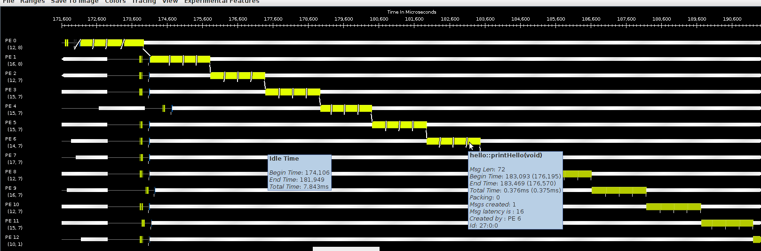
Hello World Array Projections Timeline View
Add -tracemode projections to link line to enable tracing
Run Projections tool to load trace log files and visualize performance
arrayHello on BG/Q 16 Nodes, mode c16, 1024 elements (4 per process)

Slide 64
Declaring a Chare Array
.ci file:
array [1d] foo {
entry foo(); // constructor
// ... entry methods ...
}
array [2d] bar {
entry bar(); // constructor
// ... entry methods ...
}
.C file:
struct foo : public CBase foo {
foo() { }
foo(CkMigrateMessage∗) { }
// ... entry methods …
};
struct bar : public CBase bar {
bar() { }
bar(CkMigrateMessage∗) { }

Slide 65
Constructing a Chare Array
Constructed much like a regular chare
The size of each dimension is passed to the constructor
void someMethod() {
CProxy foo::ckNew(10);
CProxy bar::ckNew(5, 5);
}
The proxy may be retained:
CProxy foo myFoo = CProxy foo::ckNew(10);
The proxy represents the entire array, and may be indexed to obtain a proxy to an individual element in the array
myFoo[4].invokeEntry();

Slide 66
thisIndex
1d: thisIndex returns the index of the current chare array element
2d: thisIndex and thisIndex.y returns the indices of the
current chare array element
.ci file:
array [1d] foo {
entry foo();
}
.C file:
struct foo : public CBase foo {
foo() {
CkPrintf(”array index = %d”, thisIndex);
}
};

Slide 67
Chare Array: Hello Example
mainmodule arr {
mainchare Main {
entry Main(CkArgMsg∗);
}
array [1D] hello {
entry hello(int);
entry void printHello();
}
}

Slide 68
Chare Array: Hello Example
#include ”arr.decl.h”
struct Main : CBase Main {
Main(CkArgMsg∗ msg) {
int arraySize = atoi(msg->argv[1]);
CProxy_hello p = CProxy_hello::ckNew(arraySize, arraySize);
p[0].printHello();
}
};
struct hello : CBase_hello {
hello(int n) : arraySize(n) { }
hello(CkMigrateMessage*) { }
void printHello() {
CkPrintf(“PE[%d]: hello from p[%d]\n”, CkMyPe90, thisIndex);
if (thisIndex == arraySize – 1) CkExit();
else thisProxy[thisIndex + 1].printHello();
}
private:
int arraySize;
};
#include “arr.def.h”

Slide 69
Hello World Array Projections Timeline View
Add -tracemode projections to link line to enable tracing
Run Projections tool to load trace log files and visualize performance
arrayHello on BG/Q 16 Nodes, mode c16, 1024 elements (4 per process)

Slide 70
Collections of Objects: Runtime Service
System knows how to ‘find’ objects efficiently: (collection, index) → processor
Applications can specify a mapping, or use simple runtime-provided
options (e.g. blocked, round-robin) Distribution can be static, or dynamic!
Key abstraction: application logic doesn’t change, even though performance might

Slide 71
Collections of Objects: Runtime Service
Can develop and test logic in objects separately from their distribution Separation in time: make it work, then make it fast
Division of labor: domain specialist writes object code, computationalist writes mapping
Portability: different mappings for dfferent systems, scales, or configurations
Shared progress: improved mapping techniques can benefit existing code

Slide 72
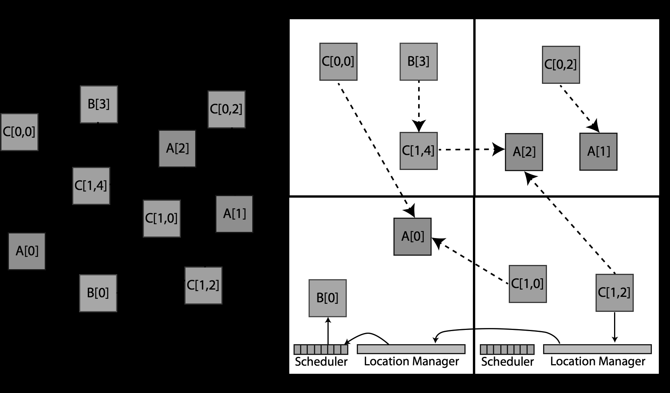
Collections of Objects

Slide 73
Collective Communication Operations
Point-to-point operations involve only two objects
Collective operations that involve a collection of objects
Broadcast: calls a method in each object of the array
Reduction: collects a contribution from each object of the array
A spanning tree is used to send/receive data

Slide 74
Broadcast
A message to each object in a collection
The chare array proxy object is used to perform a broadcast
It looks like a function call to the proxy object
From the main chare:
CProxy Hello helloArray = CProxy Hello::ckNew(helloArraySize); helloArray.foo();
From a chare array element that is a member of the same array:
thisProxy.foo()
From any chare that has a proxy p to the chare array
p.foo()

Slide 75
Reduction
Combines a set of values: sum, max, aggregate
Usually reduces the set of values to a single value
Combination of values requires an operator
The operator must be commutative and associative
Each object calls contribute in a reduction

Slide 76
Reduction: Example
mainmodule reduction {
mainchare Main {
entry Main(CkArgMsg∗ msg);
entry [reductiontarget] void done(int value);
};
array [1D] Elem {
entry Elem(CProxy_Main mProxy);
};
}

Slide 77
Reduction: Example
#include ”reduction.decl.h”
const int numElements = 49;
class Main : public CBase Main {
public:
Main(CkArgMsg∗ msg) { CProxy Elem::ckNew(thisProxy, numElements); }
void done(int value) {
CkAssert(value == numElements ∗ (numElements 1) / 2);
CkPrintf(”value: %d\n”, value); CkExit();
};
};
class Elem : public CBase Elem {
public:
Elem(CProxy Main mProxy) { int val = thisIndex; CkCallback cb(CkReductionTarget(Main, done), mProxy);
contribute(sizeof(int), &val, CkReduction::sum int, cb);
}
Elem(CkMigrateMessage∗) { }
};
#include ”reduction.def.h”
Output:
value: 1176
Program finished.

Slide 78
Outline
Introduction
Object Design
Execution Model
Hello World
Benefits of Charm++
Charm++ Basics
Object Collections
Overdecomposition
Migratability
Checkpointing and Resilience
Structured Dagger
Application Design
Performance Tuning
Using Dynamic Load Balancing
Interoperability
Debugging
Further Optimization

Slide 79
Task Parallelism with Objects
Divide-and-conquer
Each object recursively creates n objects that divide the problem into subproblems
Each object t then waits for all n objects to finish and then may ‘combine’ the responses
At some point the recursion stops (at the bottom of the tree), and some sequential kernel is executed
Then the result is propagated upward in the tree recursively
Examples: fibonacci, quick sort, . . .

Slide 80
Fibonacci Example
Each Fib object is a task that performs one of two actions:
Creates two new Fib objects to compute fib(n 1) and fib(n 2) and then waits for the response, adding up the two responses when they arrive
After both arrive, sends a response message with the result to the parent object
Or prints the value and exits if it is the root
If n = 1 or n = 0 (passed down from the parent) it sends a response message with n back to the parent object

Slide 81
Fibonacci Execution

Slide 82
Overdecomposing Your Application

Slide 83
Object-based Over-decomposition
Let the programmer decompose computation into objects
Work units, data-units, composites
Let an intelligent runtime system assign objects to processors
RTS can change this assignment (mapping) during execution
Locality of data references is a critical attribute for performance
A parallel object can access only its own data
Asynchronous method invocation for accessing other objects data
RTS can schedule work whose dependencies have been satisfied

Slide 84
Amdahls Law and Grainsize
Original “law”:
If a program has K% sequential section, then speedup is limited to .
If the rest of the program is parallelized completely
Grainsize corollary:
If any individual piece of work is > K time units, and the sequential program takes Tseq,
Speedup is limited to
So:
Examine performance data via histograms to find the sizes of remappable work units
If some are too big, change the decomposition method to make smaller units

Slide 85
Overdecomposition and Grainsize
Common misconception: overdecomposition must be expensive
(working) Definition: the amount of computation per potentially parallel event (task creation, enqueue/dequeue, messaging, locking, etc.)

Slide 86
Grainsize and Overhead
What is the ideal grainsize?
Should it depend on the number of processors?
v: overhead per message,
T_{p}: p processor completion time
g: grainsize (computation per message)

Slide 87
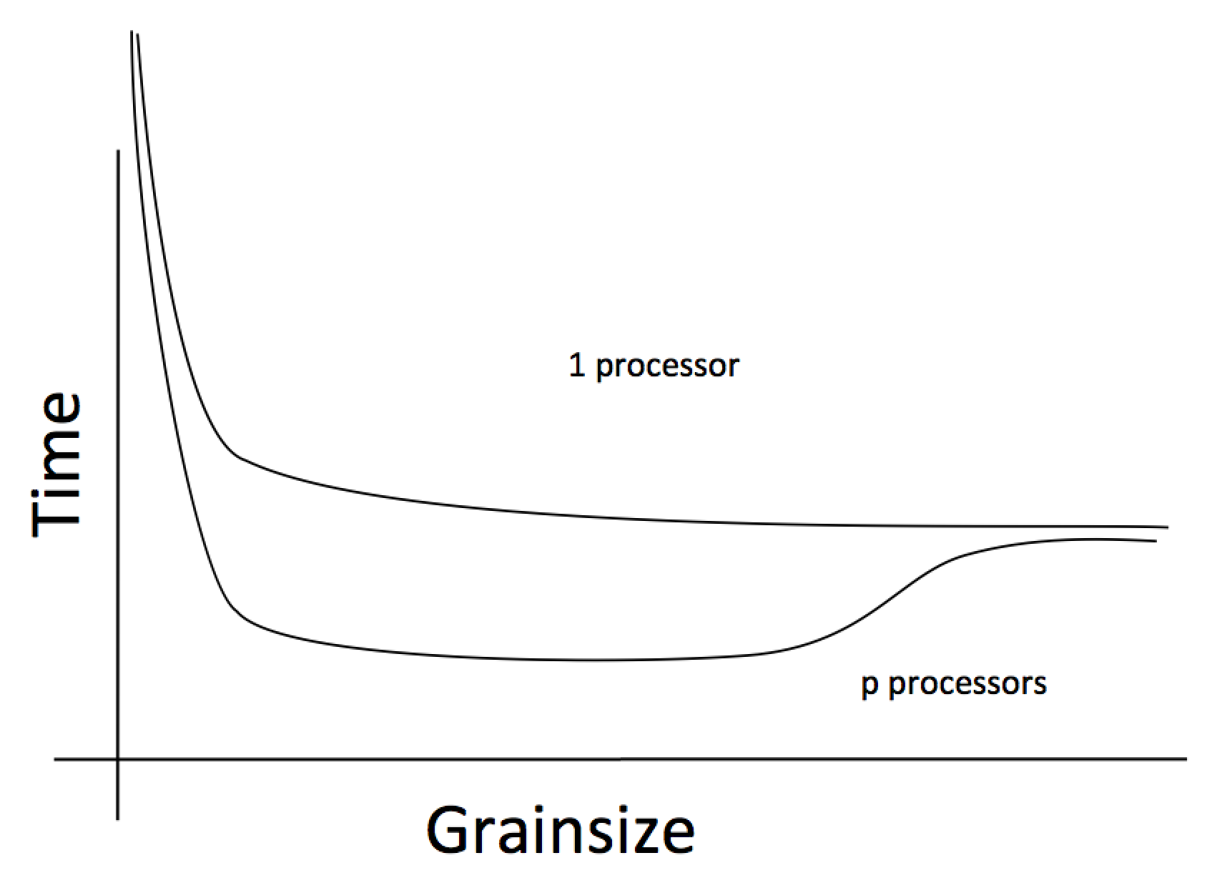
Grainsize and Scalability

Slide 88
Grainsize Study for Jacobi3D

Slide 89
Grainsize Study for Stencil Computation
Blue Waters (JYC) , 2 nodes, 32 cores each
Typically, having tens of chares per code is adequate (although reasoning should be based on computation per message)

Slide 90
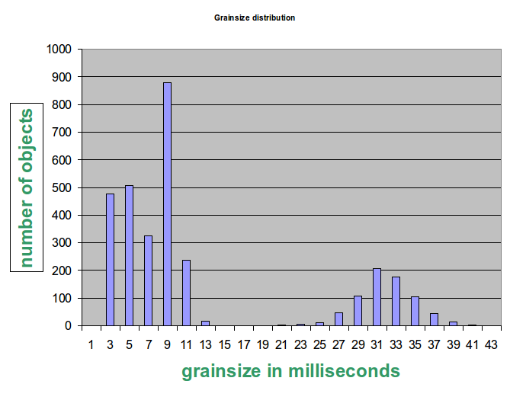
Grainsize and Load Balancing
How Much Balance Is Possible?
Solution:
Split compute objects that may have too much work, using a heuristic based on number of interacting atoms

Slide 91
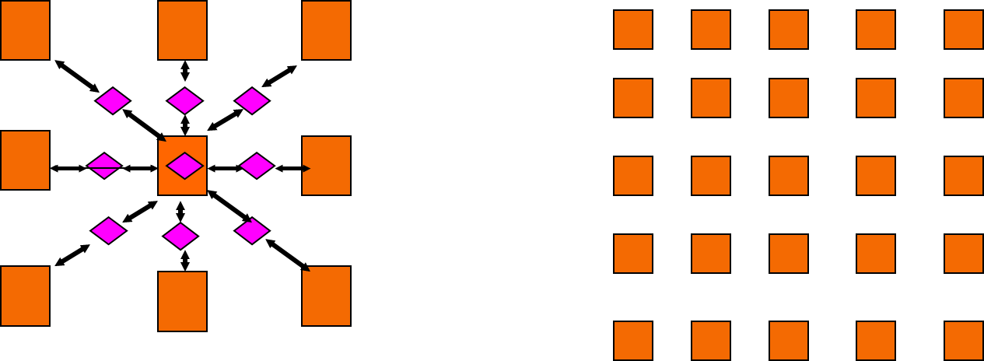
Grainsize For Extreme Scaling
Strong Scaling is limited by expressed parallelism
Minimum iteration time limited by lengthiest computation
Largest grains set lower bound
1-away generalized to k-away provides fine granularity control

Slide 92
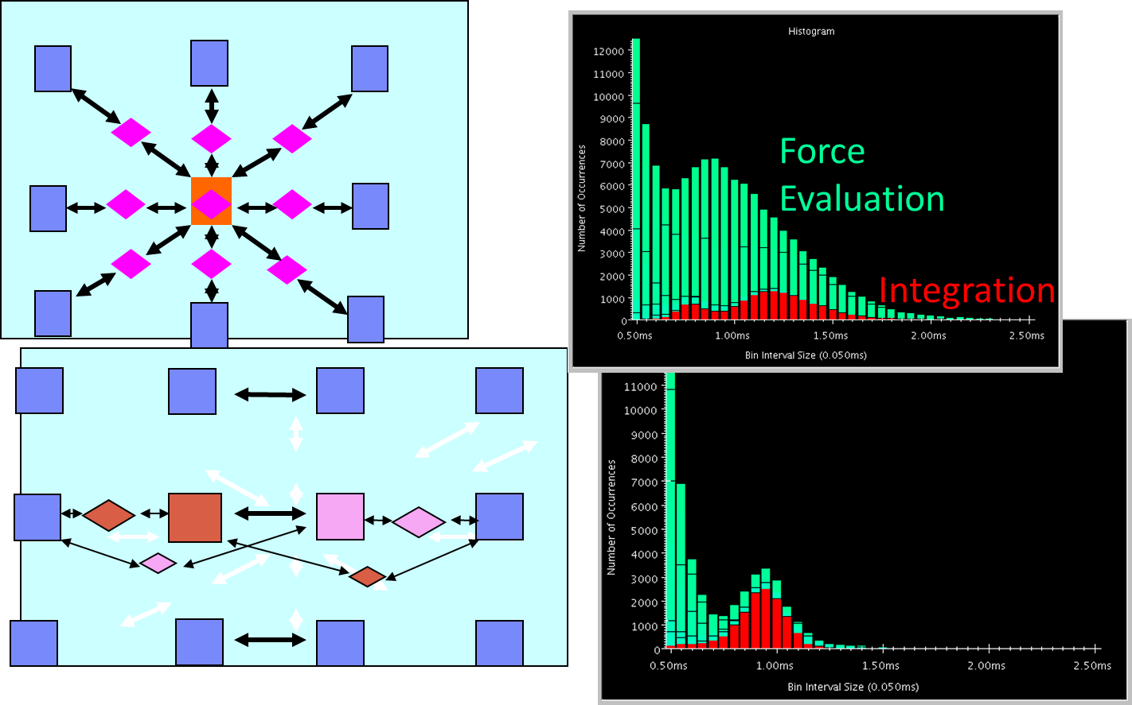
NAMD: 2-AwayX Example

Slide 93
Rules of thumb for grainsize
Make it as small as possible, as long as it amortizes the overhead
More specifically, ensure:
Average grainsize is greater than kv (say 10v)
No single grain should be allowed to be too large
Must be smaller than , but actually we can express it as: p
Must be smaller than kmv (say 100v)
Important corollary:
You can be at close to optimal grainsize without having to think about p, the number of processors
kv < g < mkv (10v < g < 100v)

Slide 94
Grain size for Fibonacci Example
Set a sequential threshold in the computational tree
Past this threshold (i.e. when n < threshold), instead of constructing two new chares, compute the fibonacci sequentially
Setting the grainsize limit at 4 (which is too small, but good for illustration)
The internal nodes of the tree do very little work, but
The coarser grains now amortize the cost of the fine-grained chares

Slide 95
Outline
Introduction
Object Design
Execution Model
Hello World
Benefits of Charm++
Charm++ Basics
Object Collections
Overdecomposition
Migratability
Checkpointing and Resilience
Structured Dagger
Application Design
Performance Tuning
Using Dynamic Load Balancing
Interoperability
Debugging
Further Optimization

Slide 96
Object Serialization Using PUP: The Pack/UnPack Framework

Slide 97
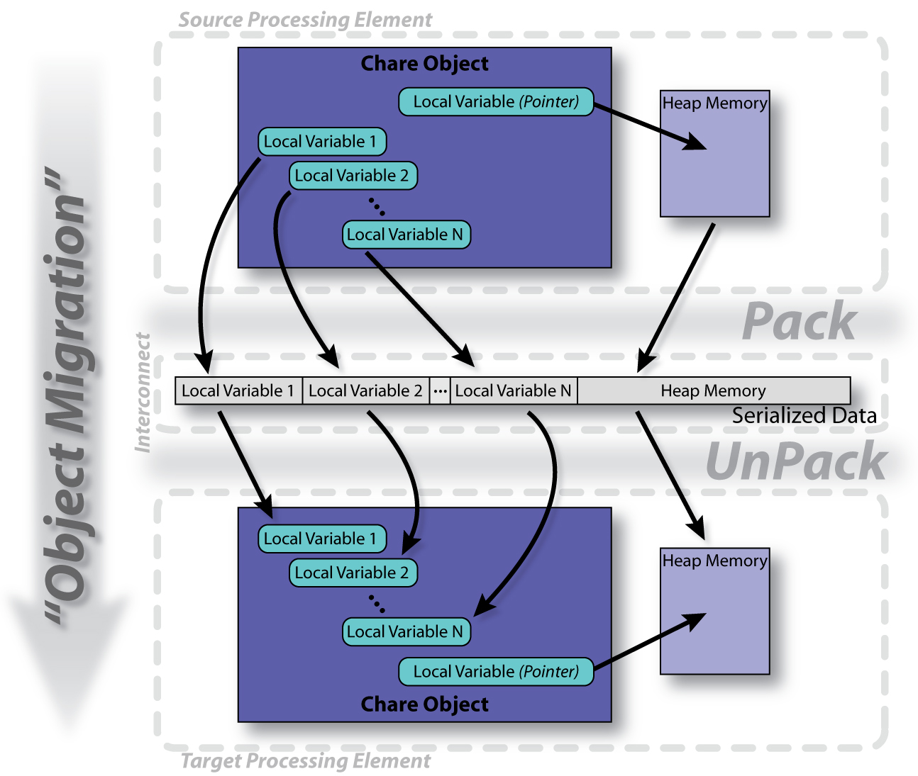
The PUP Process

Slide 98
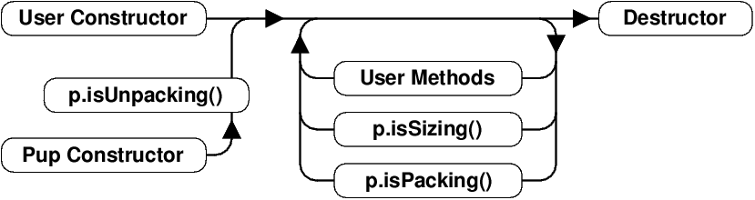
PUP Usage Sequence
Migration out:
ckAboutToMigrate I Sizing
Packing
Destructor
Migration in:
Migration constructor
UnPacking
ckJustMigrated

Slide 99
Writing a PUP routine
class MyChare : public CBase MyChare {
int a;
float b;
char c;
float localArray[LOCAL SIZE];
};
void pup(PUP::er &p) {
CBase MyChare::pup(p);
p | a;
p | b;
p | c;
p(localArray, LOCAL SIZE);
}

Slide 100
Writing a PUP routine
void pup(PUP::er &p) {
CBase MyChare::pup(p);
p | heapArraySize;
if (p.isUnpacking()) {
heapArray = new float[
heapArraySize];
}
p(heapArray, heapArraySize);
bool isNull = !pointer;
p | isNull;
if (!isNull) {
if (p.isUnpacking()) pointer =
new MyClass();
p | ∗pointer;
}
}
}
class MyChare : public
CBase MyChare {
int heapArraySize;
float∗ heapArray;
MyClass ∗pointer;
};

Slide 101
PUP: Concerns
If variables are added to an object, update the PUP routine
If the object allocates data on the heap, copy it recursively, not just the pointer
Remember to allocate memory while unpacking
Sizing, Packing, and Unpacking must scan the variables in the same order
Test PUP routines with +balancer RotateLB

Slide 102
Fault Tolerance in Charm++/AMPI
Four Approaches:
Disk-based checkpoint/restart
In-memory double checkpoint/restart
Experimental: Proactive object evacuation
Experimental: Message-logging for scalable fault tolerance
Common Features:
Easy checkpoint
Migrate-to-disk leverages object-migration capabilities
Based on dynamic runtime capabilities
Can be used in concert with load-balancing schemes

Slide 103
Checkpointing to the file system : Split Execution
The common form of checkpointing
The job runs for 5 hours, then will continue at the next allocation another day!
The existing Charm++ infrastructure for chare migration helps
Just “migrate” chares to disk
The call to checkpoint the application is made in the main chare at a synchronization point
CkCallback cb(CkIndex Hello::SayHi(),helloProxy); CkStartCheckpoint(‘‘log’’,cb);
> ./charmrun hello +p4 +restart log

Slide 104
Outline
Introduction
Object Design
Execution Model
Hello World
Benefits of Charm++
Charm++ Basics
Object Collections
Overdecomposition
Migratability
Checkpointing and Resilience
Structured Dagger
Application Design
Performance Tuning
Using Dynamic Load Balancing
Interoperability
Debugging
Further Optimization

Slide 105
Chares are reactive
The way we described Charm++ so far, a chare is a reactive entity:
If it gets this method invocation, it does this action,
If it gets that method invocation then it does that action
But what does it do?
In typical programs, chares have a life-cycle
How to express the life-cycle of a chare in code?
Only when it exists
i.e. some chars may be truly reactive, and the programmer does not know the life cycle
But when it exists, its form is:
Computations depend on remote method invocations, and completion of other local computations
A DAG (Directed Acyclic Graph)!

Slide 106
Fibonacci Example
mainmodule fib {
mainchare Main {
entry Main(CkArgMsg∗ m);
};
chare Fib {
entry Fib(int n, bool isRoot, CProxy_Fib parent);
entry void respond(int value);
};
};

Slide 107
Fibonacci Example
class Main : public CBase Main {
public: Main(CkArgMsg∗ m) {
CProxy Fib::ckNew(atoi(m−>argv[1]), true, CProxy Fib());
}
};
class Fib : public CBase Fib {
public: CProxy Fib parent; bool isRoot; int result, count;
Fib(int n, bool isRoot , CProxy Fib parent )
: parent(parent ), isRoot(isRoot ), result(0), count(2) {
if (n < 2) respond(n);
else {
CProxy Fib::ckNew(n − 1, false, thisProxy);
CProxy Fib::ckNew(n − 2, false, thisProxy);
}
}
void respond(int val) {
result += val;
if (−−count == 0 || n < 2) {
if (isRoot) {
CkPrintf(”Fibonacci number is: %d\n”, result);
CkExit();
} else
{ parent.respond(result);
delete this;
}
}
}
};

Slide 108
Consider Fibonacci Chare
The Fibonacci chare gets created
If its not a leaf,
It fires two chares
When both children return results (by calling respond ):
It can compute my result and send it up, or print it
But in our, this logic is hidden in the flags and counters . . .
This is simple for this simple example, but . . .
Lets look at how this would look with a little notational support

Slide 109
Structured Dagger The when construct
The when construct
Declare the actions to perform when a message is received
In sequence, it acts like a blocking receive
entry void someMethod() {
when entryMethod1(parameters) { /∗ block2 ∗/ }
when entryMethod2(parameters) { /∗ block3 ∗/ }
};

Slide 110
Structured Dagger The serial construct
The serial construct
A sequencial block of C++ code in the .ci file
The keyword serial means that the code block will be executed without interruption/preemption, like an entry method
Syntax serial <optionalString> { /* C++ code */ }
The <optionalString> is used for identifying the serial for performance analysis
Serial blocks can access all members of the class they belong to
Examples (.ci file):
entry void method1(parameters) {
serial
{ thisProxy.invokeMethod(10);
callSomeFunction();
}
};
entry void method2(parameters) {
serial ”setValue” {
value = 10;
}
};

Slide 111
Structured Dagger The when construct
entry void someMethod() {
serial { /∗ block1 ∗/ }
when entryMethod1(parameters) serial { /∗ block2 ∗/ }
when entryMethod2(parameters) serial { /∗ block3 ∗/ }
};
Sequence
Sequentially execute /* block1 */
Wait for entryMethod1 to arrive, if it has not, return control back to the Charm++ scheduler, otherwise, execute /* block2 */
Wait for entryMethod2 to arrive, if it has not, return control back to the Charm++ scheduler, otherwise, execute /* block3 */

Slide 112
Structured Dagger The when construct
Execute /* further sdag */ when myMethod arrives
when myMethod(int param1, int param2)
/∗ further code ∗/
Execute /* further sdag */ when myMethod1 and myMethod2 arrive
when myMethod1(int param1, int param2),
myMethod2(bool param3)
/∗ further code ∗/
Which is almost the same as this:
when myMethod1(int param1, int param2) {
when myMethod2(bool param3) { }
}
/* further code */

Slide 113
Structured Dagger Boilerplate
Structured Dagger can be used in any entry method (except for a constructor)
Can be used in a mainchare , chare , or array
For any class that has Structured Dagger in it you must insert two calls:
The Structured Dagger macro: [ClassName] _SDAG_CODE
For later: call the __sdag pup() in the pup method

Slide 114
Structured Dagger Boilerplate
The .ci file:
The .cpp file:
[mainchare,chare,array] MyFoo {
…
entry void method(parameters) {
// … structured dagger code here …
};
…
}
class MyFoo : public CBase MyFoo {
MyFoo SDAG_Code/* insert SDAG macro */
public:
MyFoo() { }
};

Slide 115
Fibonacci with Structured Dagger
mainmodule fib {
mainchare Main {
entry Main(CkArgMsg∗ m);
};
chare Fib {
entry Fib(int n, bool isRoot, CProxy_Fib parent);
entry void calc(int n) {
if (n < THRESHOLD) serial { respond(seqFib(n)); }
else {
serial {
CProxy_Fib::ckNew(n − 1, false, thisProxy);
CProxy_Fib::ckNew(n − 2, false, thisProxy);
}
when response(int val)
when response(int val2)
serial { respond(val + val2); }
}
};
entry void response(int);
};
};

Slide 116
Fibonacci with Structured Dagger
Fibonacci with Structured Dagger
#include ”fib.decl.h”
#define THRESHOLD 10
class Main : public CBase_Main {
public: Main(CkArgMsg∗ m) { CProxy_Fib::ckNew(atoi(m−>argv[1]), true, CProxy_Fib()); }
};
class Fib : public CBase_Fib {
public:
Fib SDAG CODE
CProxy_Fib parent; bool isRoot;
Fib(int n, bool isRoot , CProxy_Fib parent_)
: parent(parent_), isRoot(isRoot_) {
calc(n);
}
int seqFib(int n) { return (n < 2) ? n : seqFib(n − 1) + seqFib(n − 2); }
void respond(int val) {
if (!isRoot)
{ parent.response(val);
delete this;
} else {
CkPrintf(”Fibonacci number is: %d\n”, val);
CkExit();
}
}
};
#include “fib.def.h”

Slide 117
Structured Dagger The when construct
What is the sequence?
when myMethod1(int param1, int param2) {
when myMethod2(bool param3),
myMethod3(int size, int arr[size]) /∗ sdag block1 ∗/
when myMethod4(bool param4) /∗ sdag block2 ∗/
}
Sequence:
Wait for myMethod1 , upon arrival execute body of myMethod1
Wait for myMethod2 and myMethod3 , upon arrival of both, execute /* sdag block1 */
Wait for myMethod4 , upon arrival execute /* sdag block2 */
Question: if myMethod4 arrives first what will happen?

Slide 118
Structured Dagger The when construct
The when clause can wait on a certain reference number
If a reference number is specified for a when , the first parameter for the when must be the reference number
Semantic: the when will “block” until a message arrives with that reference number
when method1[100](int ref, bool param1)
/∗ sdag block ∗/
serial {
proxy.method1(200, false); /∗ will not be delivered to the when ∗/
proxy.method1(100, true); /∗ will be delivered to the when ∗/
}

Slide 119
Structured Dagger The if-then-else construct
The if-then-else construct:
Same as the typical C if-then-else semantics and syntax
if (thisIndex.x == 10) {
when method1[block](int ref, bool someVal) /∗ code block1 ∗/
} else {
when method2(int payload) serial {
//... some C++ code
}
}

Slide 120
Structured Dagger The for construct
The for construct:
Defines a sequenced for loop (like a sequential C for loop)
Once the body for the ith iteration completes, the i + 1 iteration is started
for (iter = 0; iter < maxIter; ++iter) {
when recvLeft[iter](int num, int len, double data[len])
serial { computeKernel(LEFT, data); }
when recvRight[iter](int num, int len, double data[len])
serial { computeKernel(RIGHT, data); }
}
iter must be defined in the class as a member
class Foo : public CBase_Foo {
public: int iter;
};

Slide 121
Structured Dagger The while construct
The while construct:
Defines a sequenced while loop (like a sequential C while loop)
while (i < numNeighbors) {
when recvData(int len, double data[len]) {
serial {
/∗ do something ∗/
}
when method1() /∗ block1 ∗/
when method2() /∗ block2 ∗/
}
serial { i++; }
}

Slide 122
Structured Dagger The overlap construct
The overlap construct:
By default, Structured Dagger defines a sequence that is followed sequentially
overlap allows multiple independent clauses to execute in any order
Any constructs in the body of an overlap can happen in any order
An overlap finishes in sequence when all the statements in it are executed
Syntax overlap { /* sdag constructs */ }
What are the possible execution sequences?
serial { /∗ block1 ∗/ }
overlap {
serial { /∗ block2 ∗/ }
when entryMethod1[100](int ref_num, bool param1) /∗ block3 ∗/
when entryMethod2(char myChar) /∗ block4 ∗/
}
serial { /∗ block5 ∗/ }

Slide 123
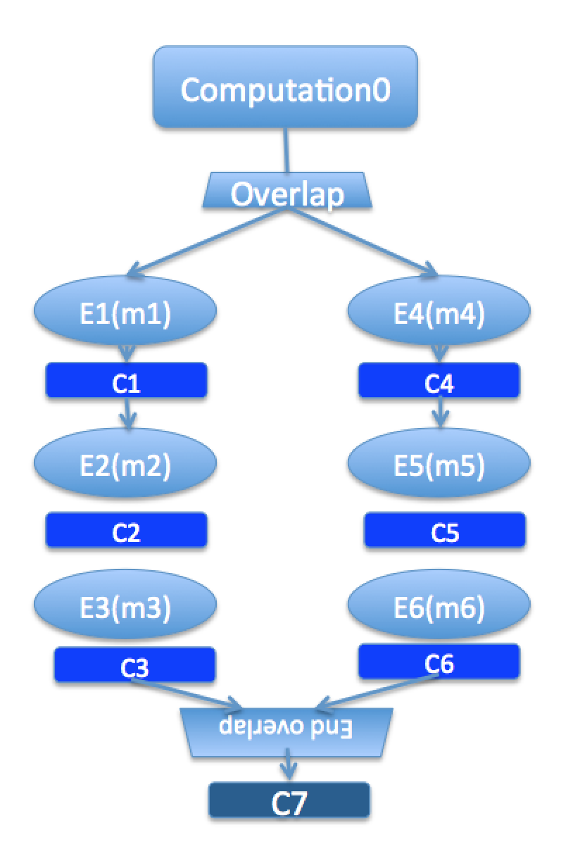
Illustration of a long “overlap”
Overlap can be used to get back some of the asynchrony within a chare
But it is constrained
Makes for more disciplined programming,
with fewer race conditions

Slide 124
Structured Dagger The forall construct
The forall construct:
Has “do-all” semantics: iterations may execute an any order
Syntax:
forall [<ident>] (<min> : <max>, <stride>) <body>
The range from <min> to <max> is inclusive
forall [block] (0 : numBlocks − 1, 1) {
when method1[block](int ref, bool someVal) /∗ code block1 ∗/
}
Assume block is declared in the class as public: int block;

Slide 125
Parallel Prefix with SDAG: .ci file I
mainmodule prefix {
mainchare Main {
entry Main(CkArgMsg∗ msg);
entry [reductiontarget] void checkIn();
};
array [1D] Prefix {
entry Prefix(int n, CProxy_Main m);
entry void passValue(int step, unsigned int incomingValue);

Slide 126
Parallel Prefix with SDAG: .ci file II
entry void startPrefixCalculation() {
for(stage = 0; (1 << stage) < numElements; stage++) {
serial ”send_value” {
targetIndex = thisIndex + (1<<stage);
if (targetIndex < numElements)
thisProxy[targetIndex].passValue(stage, value);
}
if (thisIndex >= (1<<stage))
when passValue[stage] (int incoming_stage, unsigned int incoming_value) serial
{
value += incoming_value;
}
}
serial ”done” {
contribute(CkCallback(CkReductionTarget(Main, checkIn), mainProxy));
}
};
};
};

Slide 127
Parallel Prefix with SDAG: .C file I
#include ”prefix.decl.h”
#include <stdlib.h>
class Main : public CBase_Main {
public:
CProxy_Prefix prefixArray;
Main(CkArgMsg∗ msg) {
int numElements = 10;
if (msg>argc > 1)
numElements = atoi(msg>argv[1]); prefixArray = CProxy_Prefix::ckNew(numElements, thisProxy, numElements);
prefixArray.startPrefixCalculation();
} Main(CkMigrateMessage∗ msg) { }
void checkIn() {
CkExit();
};
};

Slide 128
Parallel Prefix with SDAG: .C file II
class Prefix : public CBase_Prefix {
Prefix_SDAG_CODE
public:
int stage, targetIndex, value, numElements;
CProxy_Main mainProxy;
Prefix(int n, CProxy_Main p) : numElements(n), mainProxy(p) {
srand(thisIndex);
value = rand() % 10; // Random positive int between 0 and 9 (inclusive)
}
Prefix(CkMigrateMessage ∗msg) { }
};
#include ”prefix.def.h”

Slide 129
Stencil Codes
Iterative applications where array elements are updated according to some fixed pattern.
Used in computational simulations, solving partial differential equations, Jacobi kernel, GaussSeidel method, image processing applications etc.
Can be 2D or 3D

Slide 130
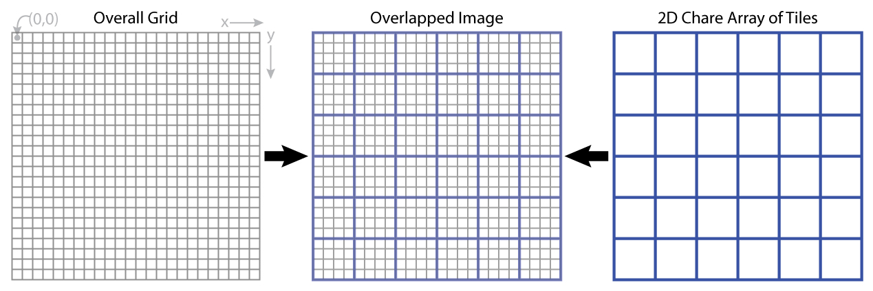
5-point Stencil

Slide 131
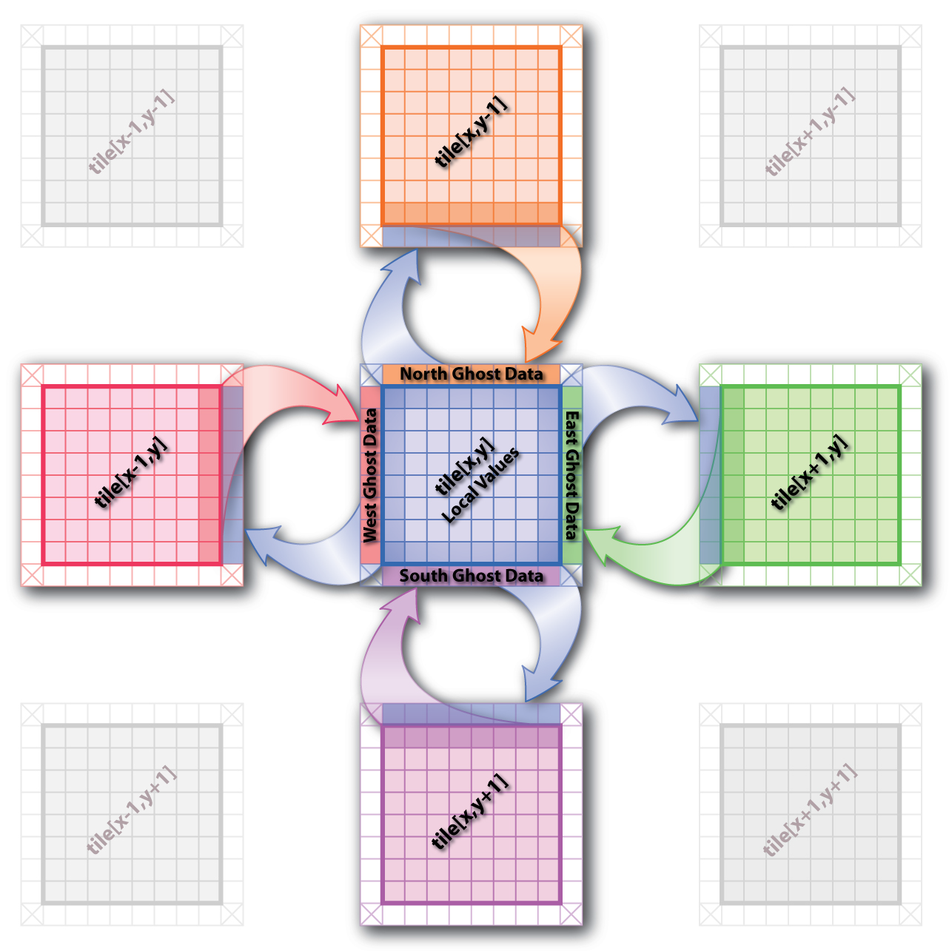
5-point Stencil

Slide 132
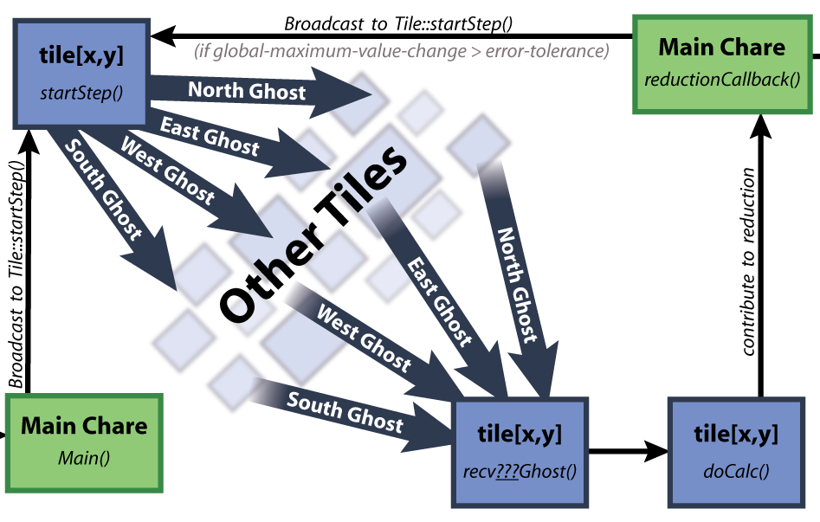
5-point Stencil

Slide 133
Jacobi: .ci file
mainmodule jacobi3d {
mainchare Main {
entry Main(CkArgMsg ∗m);
entry void done(int iterations);
};
array [3D] Jacobi {
entry Jacobi(CProxy_Main);
entry void updateGhosts(int ref, int dir, int w, int h, double gh[w∗h]);
entry [reductiontarget] void checkConverged(bool result);
entry void run() {
// ... main loop (next slide) ...
};
};
};

Slide 134
Jacobi: .ci file
while (!converged) {
serial {
copyToBoundaries(); int x = thisIndex.x, y = thisIndex.y, z = thisIndex.z; int bdX = blockDimX, bdY = blockDimY, bdZ = blockDimZ;
thisProxy(wrapX(x1),y,z).updateGhosts(iter, RIGHT, bdY, bdZ, rightGhost);
thisProxy(wrapX(x+1),y,z).updateGhosts(iter, LEFT, bdY, bdZ, leftGhost);
thisProxy(x,wrapY(y1),z).updateGhosts(iter, TOP, bdX, bdZ, topGhost);
thisProxy(x,wrapY(y+1),z).updateGhosts(iter, BOTTOM, bdX, bdZ, bottomGhost);
thisProxy(x,y,wrapZ(z1)).updateGhosts(iter, BACK, bdX, bdY, backGhost);
thisProxy(x,y,wrapZ(z+1)).updateGhosts(iter, FRONT, bdX, bdY, frontGhost); freeBoundaries();
}
for (remoteCount = 0; remoteCount < 6; remoteCount++) when updateGhosts[iter](int ref, int dir, int w, int h, double buf[w∗h]) serial {
updateBoundary(dir, w, h, buf);
}
serial {
double error = computeKernel(); int conv = error < DELTA; CkCallback cb(CkReductionTarget(Jacobi, checkConverged), thisProxy);
contribute(sizeof(int), &conv, CkReduction::logical and, cb);
}
when checkConverged(bool result) if (result) serial { mainProxy.done(iter); converged = true; }
serial { ++iter; }
};
};

Slide 135
Jacobi: .ci file (with asynchronous reductions)
entry void run() {
while (!converged) {
serial {
copyToBoundaries();
int x = thisIndex.x, y = thisIndex.y, z = thisIndex.z;
int bdX = blockDimX, bdY = blockDimY, bdZ = blockDimZ;
thisProxy(wrapX(x−1),y,z).updateGhosts(iter, RIGHT, bdY, bdZ, rightGhost);
thisProxy(wrapX(x+1),y,z).updateGhosts(iter, LEFT, bdY, bdZ, leftGhost);
thisProxy(x,wrapY(y−1),z).updateGhosts(iter, TOP, bdX, bdZ, topGhost);
thisProxy(x,wrapY(y+1),z).updateGhosts(iter, BOTTOM, bdX, bdZ, bottomGhost);
thisProxy(x,y,wrapZ(z−1)).updateGhosts(iter, BACK, bdX, bdY, backGhost);
thisProxy(x,y,wrapZ(z+1)).updateGhosts(iter, FRONT, bdX, bdY, frontGhost);
freeBoundaries();
}
for (remoteCount = 0; remoteCount < 6; remoteCount++)
when updateGhosts[iter](int ref, int dir, int w, int h, double buf[w∗h]) serial {
updateBoundary(dir, w, h, buf);
}
serial {
double error = computeKernel();
int conv = error < DELTA;
if (iter % 5 == 1)
contribute(sizeof(int), &conv, CkReduction::logical and, CkCallback(CkReductionTarget(Jacobi,
checkConverged), thisProxy));
}
if (++iter % 5 == 0)
when checkConverged(bool result)
if (result) serial { mainProxy.done(iter); converged = true; }
}
};

Slide 136
Power of Asynchrony Example
Consider the following problem:
A large number of key-value pairs are distributed on several (hundred) processors (or chares)
Each chare needs to get some subset of these values before they can proceed to the next phase of the computation
The set of keys needed are not known in advance: they are determined based on the input data

Slide 137
Structured dagger version
entry void retrieveValues {
for (i = 0; i < n; i++) serial {
keys[i] = // compute i’th key;
keyValueProxy[keys[i] / B].requestValue(keys[i], thisProxy, i);
}
for (i = 0; i < n; i++)
when response(int i, ValueType value)
serial { values[i] = value; }
};
// next phase of computation thats uses the keys and values.
KeyValueClass::requestValue(int key, CProxy Client c, int ref) {
ValueType v = localTable[key];
c.response(ref, v);
}

Slide 138
Outline
Introduction
Object Design
Execution Model
Hello World
Benefits of Charm++
Charm++ Basics
Object Collections
Overdecomposition
Migratability
Checkpointing and Resilience
Structured Dagger
Application Design
Performance Tuning
Using Dynamic Load Balancing
Interoperability
Debugging
Further Optimization

